Slide 1
Introduction to Programming
Intro to C, compilation and Hello World

Slide 2
Pseudo-code
Used to outline the general logic of an algorithm.
Syntax is not fixed
Recipe Example

Slide 3
Understanding Memory
Random-access memory (RAM /ræm/) is a form of computer memory that can be read and changed in any order, typically used to store working data and machine code.[1
The Operating system is responsible, for loading the machine code of a computer program into memory.
X86 architecture is limited to a 32-bit memory address = 4GB Memory maximum
X64 architecture supports up to 16 Exabytes = 1 millon terabytes
Notes:
1. https://en.wikipedia.org/wiki/Cambridge_English_Dictionary

Slide 4
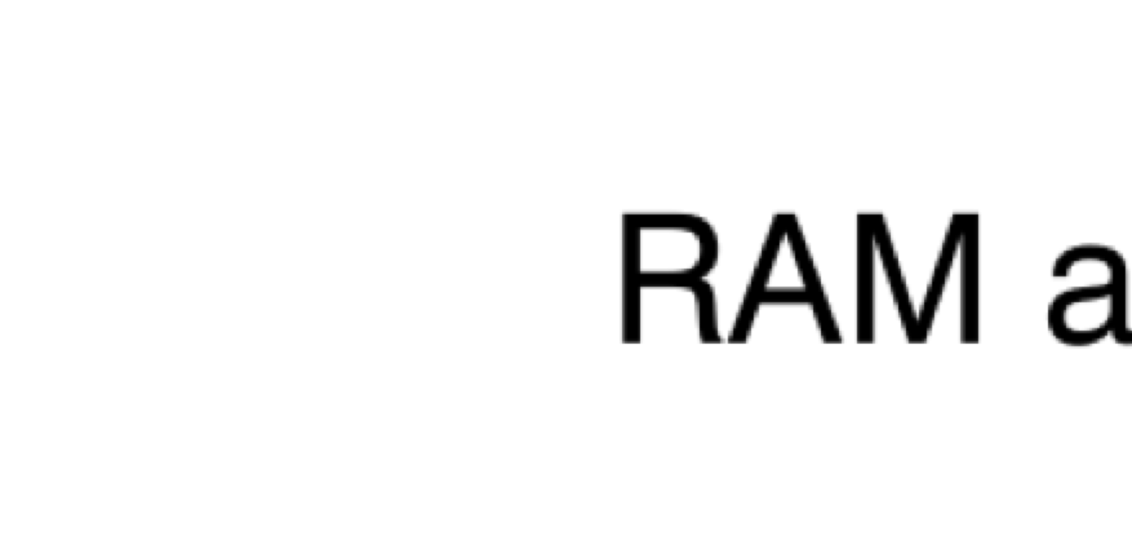
RAM addressation
Notes:
https://www.nayuki.io/page/a-fundamental-introduction-to-x86-assembly-programming

Slide 5
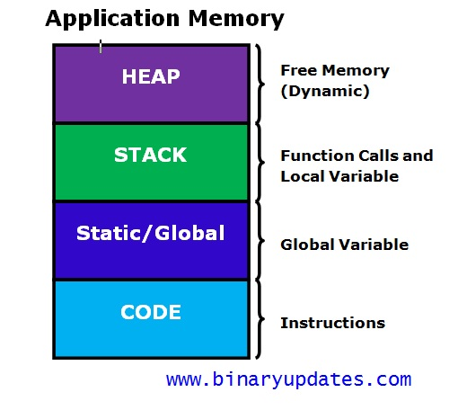
Application memory model

Slide 6
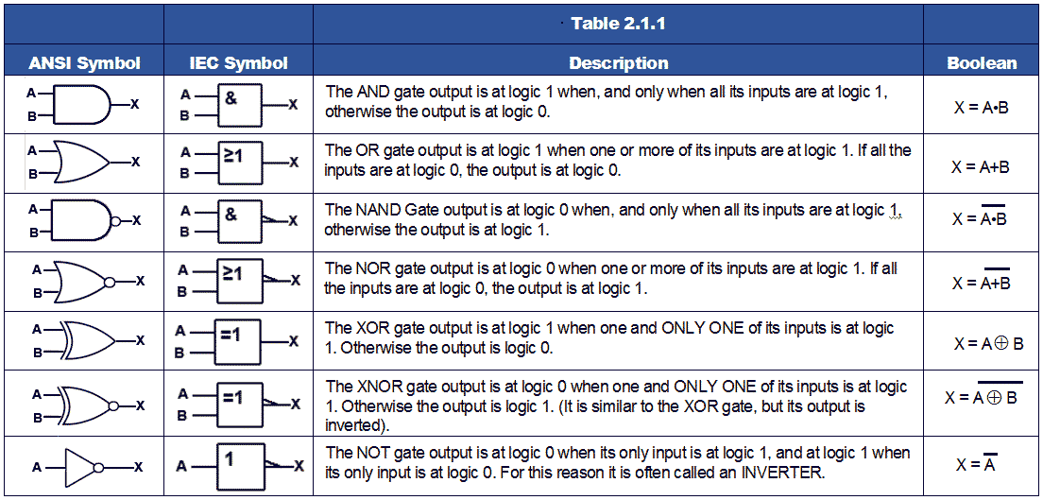
Understanding Processors – Logic Gates

Slide 7
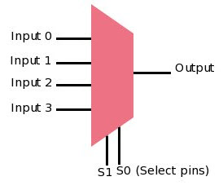
Understanding Processors – Multiplexers

Slide 8
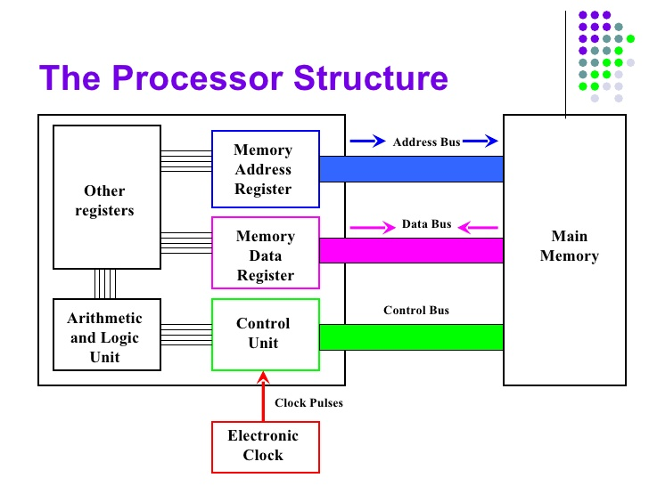
Understanding Processors – Core architecture

Slide 9
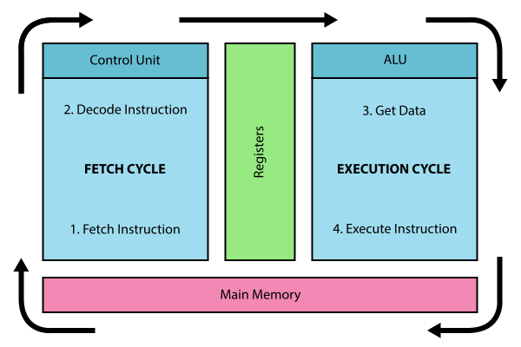
Understanding Processors – Fetch Decode Execute Cycle

Slide 10
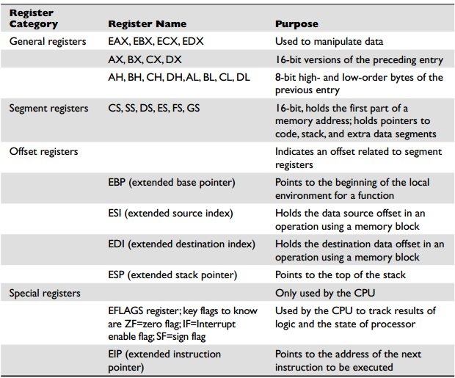
X86 Assembly - key registers

Slide 11
Understanding Assembly
Instruction set reference - https://www.felixcloutier.com/x86/

Slide 12
Add two numbers in assembly
section .text
global main //Define start of subroutine
extern printf //Call external function definition
main:
mov eax, 45 // Move the value 45 into the EAX register
mov ebx, 55 // Move the value 55 into the EBX Register
add eax,ebx // Add the value of the data in EBX to EAX
push eax // Push the value of EAX onto the stack
push message // Push the value of the message variable to the stack
call printf //call print function
add esp, 8 //Increase the ESP (Extended stack pointer) to the next address
ret
message db "Value = %d", 10, 0

Slide 13
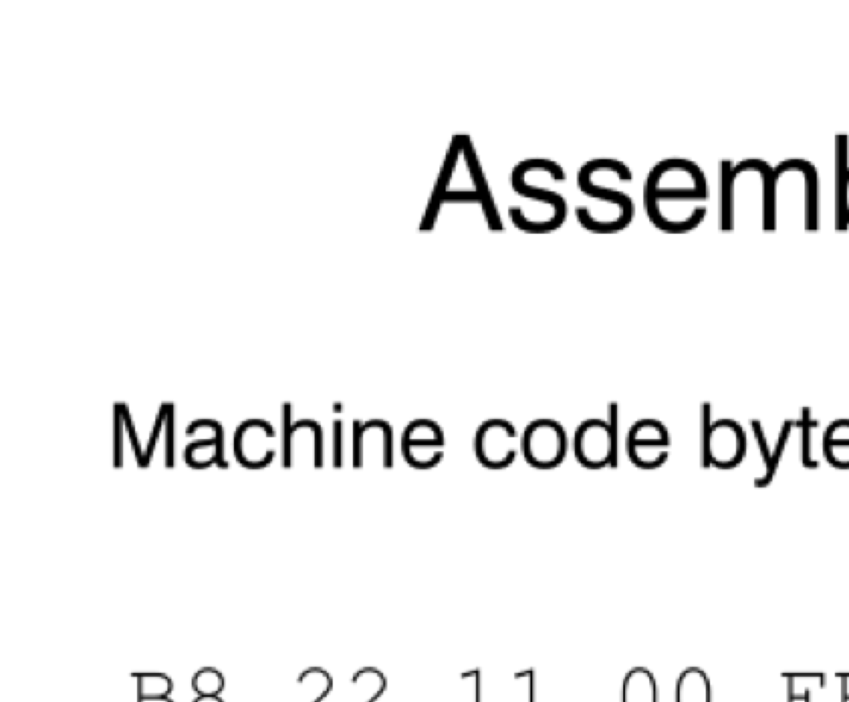
Understanding machine code
Notes:
Step 1: gcc -S main.c
Step 2: gcc -c main.c
Step 3: gcc main.c

Slide 14
Understanding Compilation
Compilation - the translation of source code into object code(machine code) by a compiler. Step 1 - Compilation into an assembly source Step 2 - The assembly source is translated into an object file binary Step 3 - The object file is linked with any necessary external functions to produce an executable.
Notes:
gcc memory-layout.c -o memory-layout

Slide 15
The C Language
C (/siː/, as in the letter c) is a general-purpose, procedural computer programming language supporting structured programming, lexical variable scope, and recursion, while a static type system prevents unintended operations.

Slide 16
The C Language
A C-program source file is a file with the extension “.c”
The source file contains code, which will be compiled by the complier into a binary. (A runnable program.)
The source consists of statements, which in turn consist of tokens.
A token is either a keyword, an identifier, a constant, a string literal or a symbol.
A statement is essentially a command to be executed.
A statement is always ended by a semicolon
Whitespace (tabs, blanks, empty lines) is ignored.
Comments are ignored.

Slide 17
The C Language - Keywords
These words are reserved by the compiler, and should not be used for variable names.
auto | else | long | switch
break | enum | register | typedef
case | extern | return | union
char | float | short | unsigned
const | for | signed | void
continue | goto | sizeof | volatile
default | if | static | while
do | int | struct | _Packed
double

Slide 18
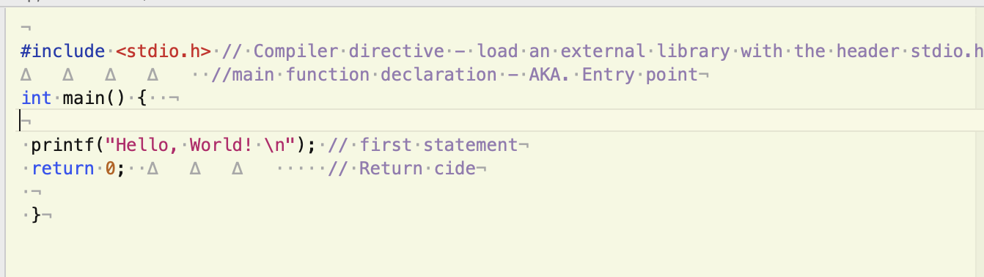
Anatomy of ”Hello World”

